Slide 1
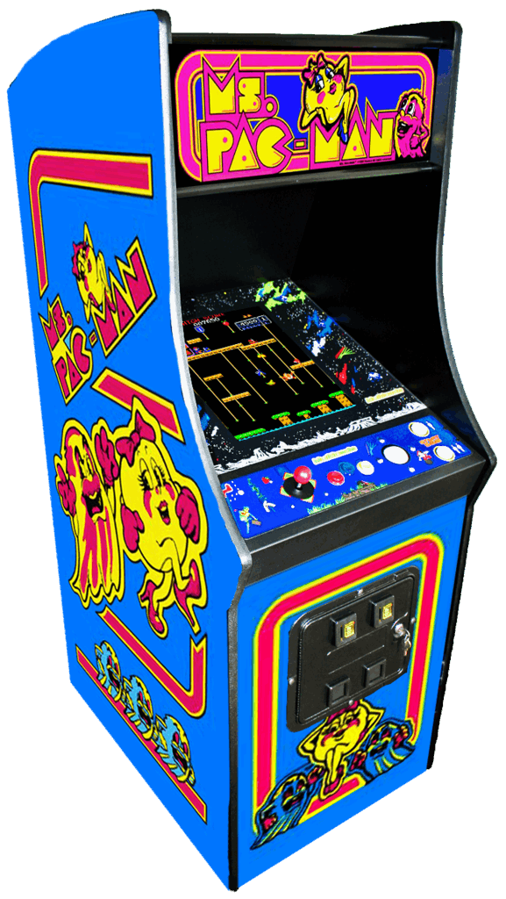
First Learning Project Final Review
Game Designed by : -
> Ansuman Mahapatra(23CSE522)
> Biswajeet Patra(23CSE531)
> Tapan Kumar Sahoo(23CSE549)
Dt – 15/11/2024

Slide 2
INTRODUCTION
Overview of Pac-Man:
Pac-Man is one of the most iconic and enduring video games, originally released in 1980.
Known for its simple yet addictive gameplay and its impact on gaming culture.
About the Project:
We developed a modern version of Pac-Man as a personal project to explore game development.
Purpose of the Presentation:
To showcase the development process of my Pac-Man game.
Share insights and learnings from creating a game inspired by a basic knowledge.

Slide 3
CONTENT :
Why We Chose Pac-Man:
We've always loved playing games for strategic and challenging movement.
The thrill of outsmarting the ghosts made us want to create our own version.
Power Pellet Inspiration:
The Power Pellet mechanic, where Pac-Man can turn the tables on the ghosts, particularly inspired me and my friends.
In our version, I’ve enhanced the Power Pellet’s impact to make it even more exciting and central to the game.

Slide 4

GAME ELEMENTS
Here the list of the elements we needed to design the pac-man game : -
>Image Folder
• 3 Pac-Man animation image
• 3 Ghosts image
• Food (Pellet ) image
• Pink dot ( Booster )
• Wall image
>Src Holder Folder
It consists of all the .js (JavaScript) files .
>Index.html file

Slide 5
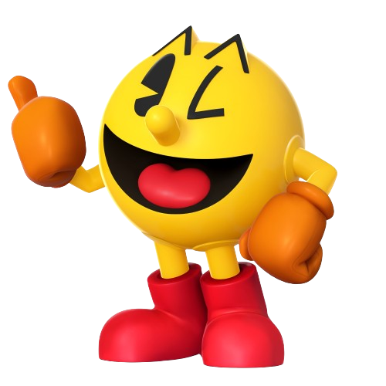
TECHNOLOGY USED
We used HTML , CSS , Java Script and some images to make the project Pac-Man .
We make all the things by vs code .

Slide 6
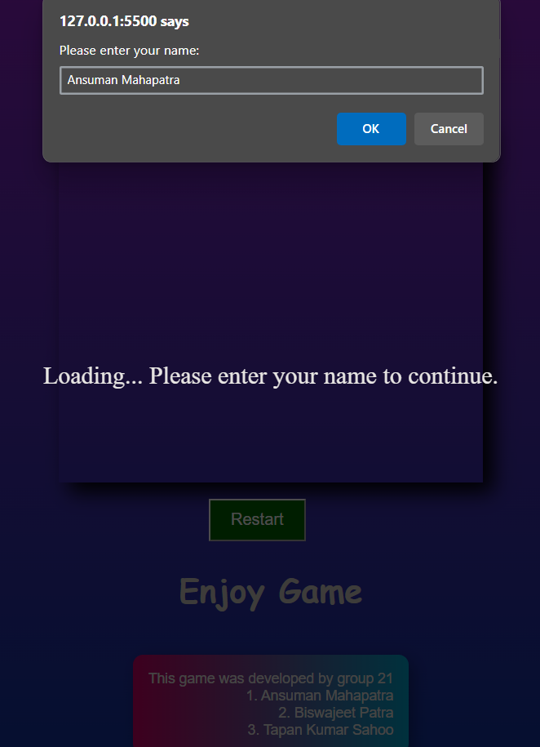
GAME LOGIC
In the game when the user can start the game then the site ask the user for his/her name . When user enter the name then the shown to the user . Then using arrow up , down , left , right key . By avoiding the ghosts if the pac-man eats all the pellets then it wons . If the pac-man touches the ghosts the the game overs. For that we add some boosters in the game that when the pac-man eat them then all ghosts get blue color for some times and the pac-man can simply eats them . Also there is a restart button that restart the game for the new user .

Slide 7
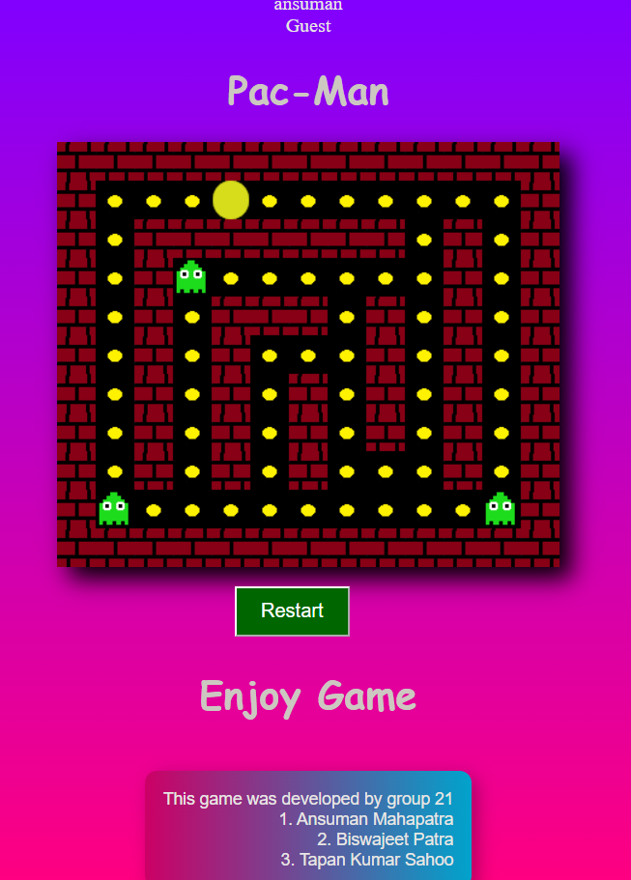
CONCLUSION : -
This will take a more time to make the project logic and the design according to that . But how ever I completed the Project of Pac-Man in time . I was much more difficult than I expected .

